Slide 1




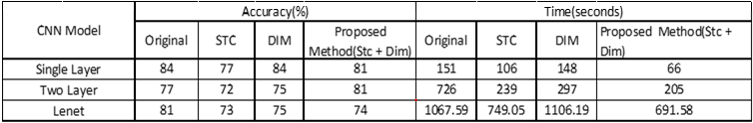
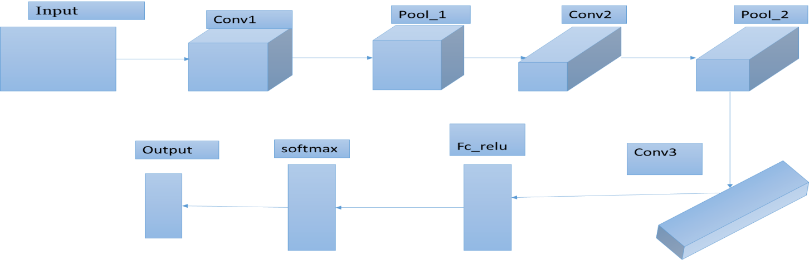
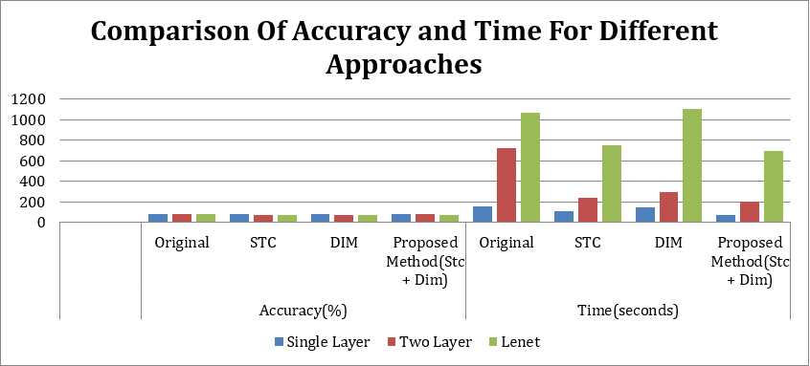
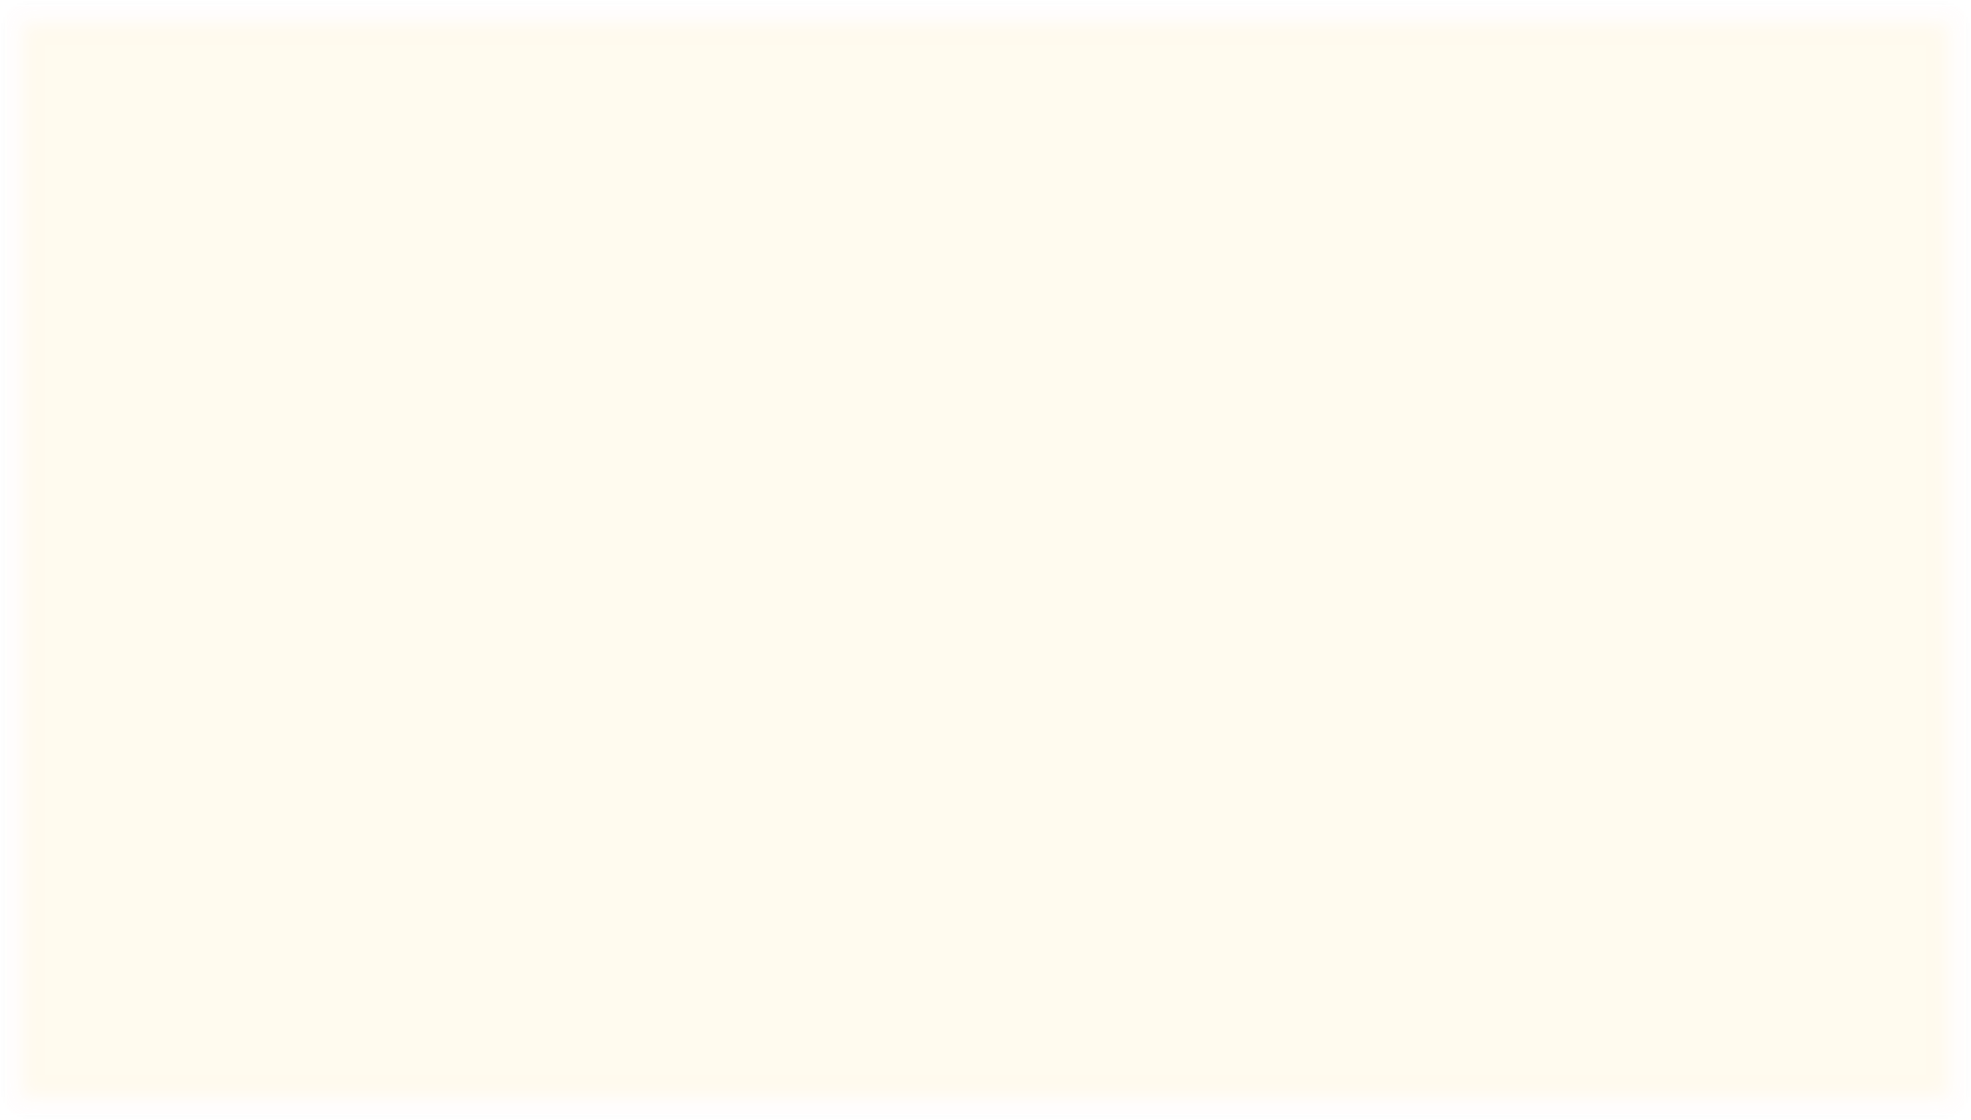
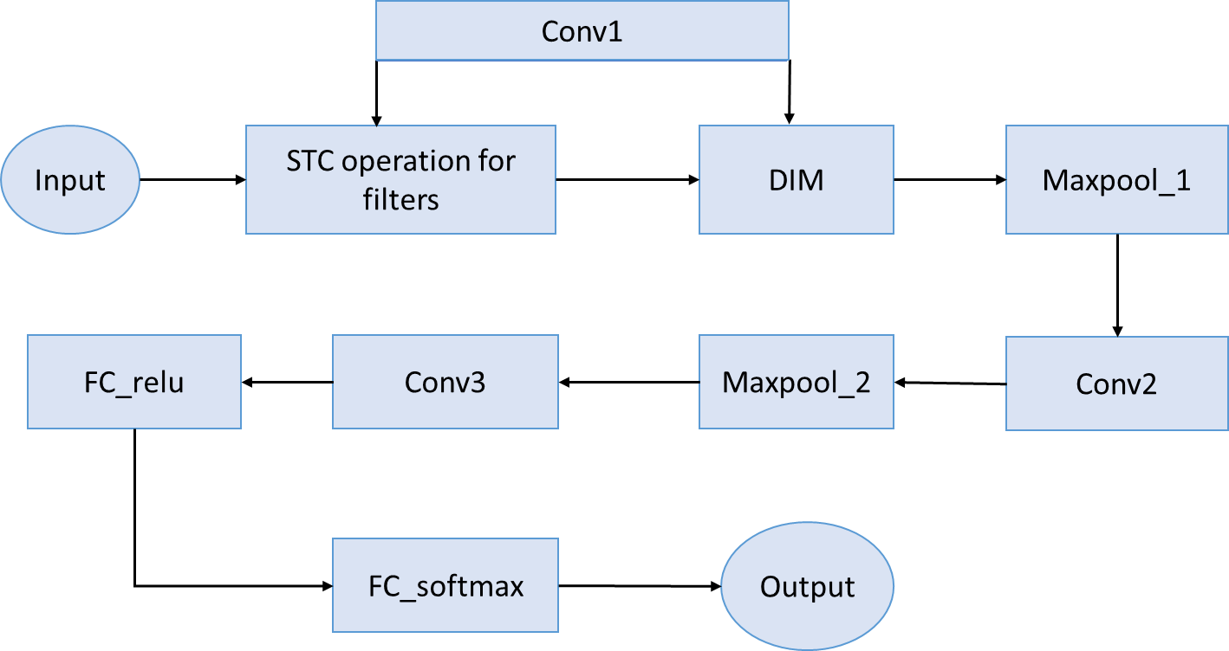
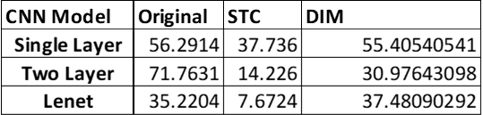
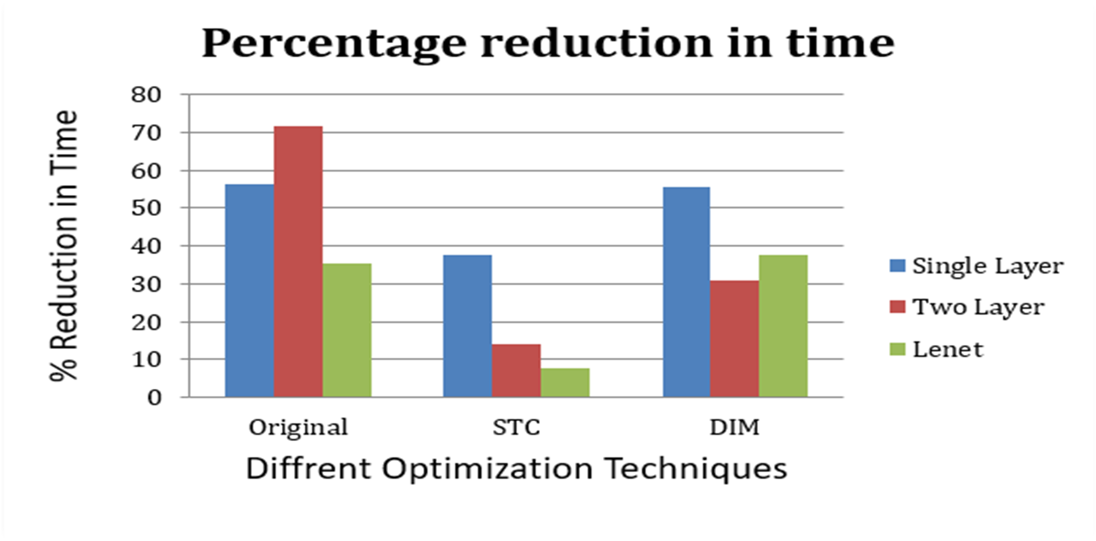
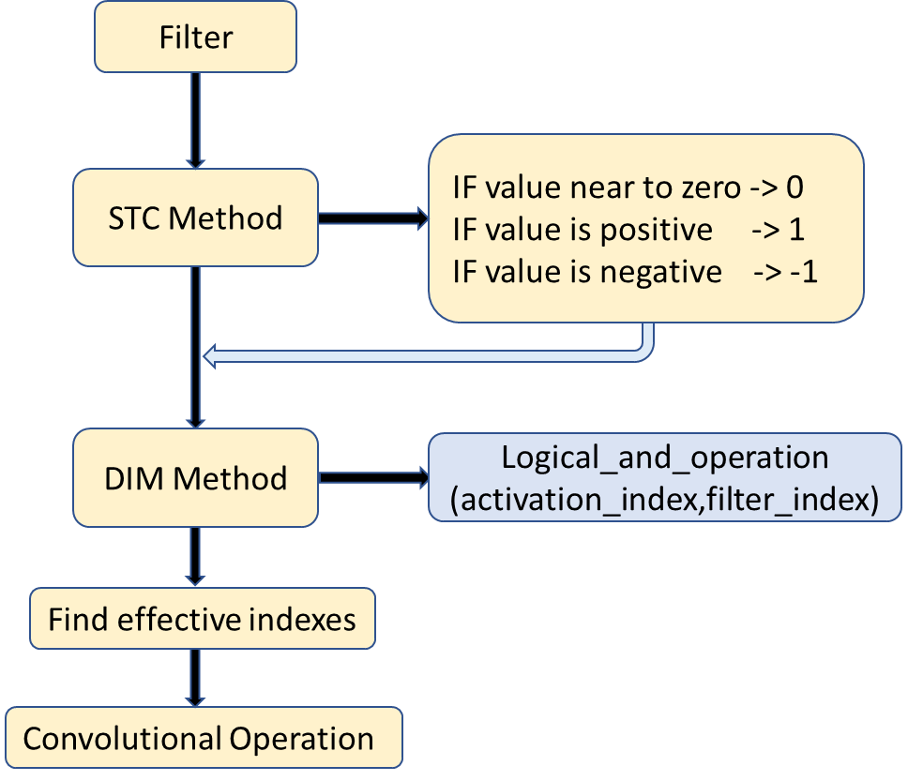

Optimized Implementation of CNN
Krishna Kothagorla Aishwarya Joshi Mayank Goyal Prapti Darvekar Mahima Kothari
DR. Vijaypal Singh Rathor
Abstract
Result Table 1:Comparison of Accuracy and Time For Different Approaches
For most deep learning Algorithms training is Notoriously
time consuming. Since most of the computation in training neural Networks is typically spent on floating point multiplication, we apply an Approach to training that eliminates the need for most of these.
our method consists of two parts:
Sparse Ternary Connect(STC)
Dual Indexing Module(DIM)
Introduction
In recent years, Deep learning has been used extensively in a wide range of fields. In Deep learning, Convolutional Neural Networks are found to give the most accurate results in solving real world problems such as computer vision, mainly in face recognition, scene labelling, image classification, action recognition, human pose estimation and document analysis. CNN is also used in the field of speech recognition and text classification for natural language
processing.
.
But Training deep neural networks has long been computational demanding and time consuming.
For some state-of-the art architectures, it can take weeks to get models trained. Another problem is that the demand for memory can be huge.
Most of the computations performed in training a neural network are
ﬂoating point multiplications. In our model, we focused on eliminating most of these multiplications to reduce computation.
STC reduces time and DIM improves accuracy. In our proposed method, we have combined the STC and DIM technics. This reduction in the time is because of further reduction of number of multiplications in our method.
One thing to note is that we have optimized only the time taken by the forward propagation in the CNN in future we extend this method to the back-propagation and can still optimize the CNN.
Result Table 2 : Percentage Reduction In Time
Flowchart of our project implementation
Proposed Method
We have used single layer, two layer and Lenet-5 architecture for our CNN model.
To optimize CNN model we have used STC and DIM.
Using STC and DIM together results in achieving good accuracy in less time as compared to original one.
Steps for implementation of proposed method :
1]Initialize filters with random values. 2]Apply STC technique, in that we have convert original filter matrix into ternarized form(according to rho value)
Apply DIM technique, in this method we have considered only non-zero values from both filters and input for multiplication(i.e. we have to find effective indexes)
Perform Convolution Operation
Conclusions
In the recent years, CNN is being used for varied tasks like Face recognition , Stock market price prediction, OCR etc.
The applications which have security importance need to much robust. But to build such an application, we need to train with huge amount of data which may sometimes take some weeks.
With this optimized implementation of CNN , we can train huge amount of data easily in less amount of time and can build a robust CNN.
Experimental Results and Discussion
The below results show the comparison of time taken and accuracy between Original method, STC, DIM and our proposed architecture on MNIST dataset.
It can be seen that our proposed method takes less time compared to other methods without much loss in accuracy.
For CNN with single layer and two layers, our proposed method takes less than half the time taken by the original CNN .
References
https://cs231n.github.io/convolutional-networks/
https://www.youtube.com/watch?v=ZOXOwYUVCqw&t=374s
Sparse Ternary Connect: Convolutional Neural Networks Using Ternarized
Supporting Compressed-Sparse Activations and Weights
Team No. - 66
www.postersession.com
m
co
.
n o
ssi
se
r
e
st
o
p
.
w
w w

